Slide 1
Wednesday, April 29, 2015
2:00-3:00 PM ET
Audience: All WIC Agencies
Notes:
Welcome and thank you for participating in the Value Enhanced Nutrition Assessment (VENA) webinar. My name is Donna Hines, Chief of the Policy Branch at the Food and Nutrition Service National office. We are pleased to present this series of webinars with the purpose of revitalizing VENA and to assist State and local agencies in their continued implementation of VENA.

Slide 2
Hitting the Mark:
Putting VENA Into Action
Presented by
Arizona WIC – Jaclyn Chamberlain, Marlene Williams
Oregon WIC – Vernita Reyna, Kim McGee
Notes:
Today, we are thrilled to have representatives from the Arizona WIC Program: Jaclyn Chamberlain & Marlene Williams; and from Oregon WIC: Vernita Reyna and Kim McGee present: Hitting the Mark: Putting VENA Into Action.
I will now turn it over to Jaclyn.

Slide 3
Hitting the Mark:
Putting VENA Into Action

Slide 4
Defining the Target
Accountability to Change in AZ WIC
Notes:
Hello and welcome from AZ! I’m Jaclyn Chamberlain, Training Manager with the AZ WIC Program and I’m Marlene Williams, Program Integrity Manager. Today we are going to be sharing how we incorporated PCS into our performance expectations for staff. Specifically, we have attempted to take the black and white “nitty gritty” from the policy and procedure manual and the grey, abstract world of the PCS approach and translate that to targets, or performance expectations.

Slide 5
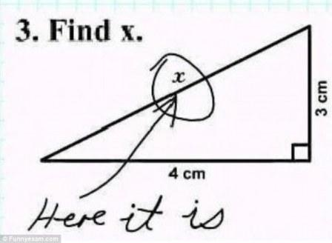
Why?
“Working” on VENA/PCS for Several Years
Observations = Status Quo?
Notes:
When we first started exploring Participant Centered Services and what that means in a WIC setting, there was a lot of discussion about how difficult it can be to define. The concept is abstract. The vary nature of the individualized approach means that it is not a black and white, one size fits all appointment. We went forward and provided training, mentoring, we asked for feedback, revised policies accordingly, and ultimately changed our assessment process to allow for more flexibility and individualization. All the while, trusting that “if you build it, they will come” and that incorporation of PCS would happen naturally.
What we found, through observations, MEs and feedback from our agencies was that really, it did not come naturally. Part of this may be the nature of how we approached it, because it was an abstract, the concrete understanding of concepts may have been lacking. The approach may have not met all learners needs. Or, there were honest attempts to incorporate, but perhaps because it was so grey, the results weren’t really what we envisioned. Similar to this student’s correct, but incorrect, approach to this equation.

Slide 6
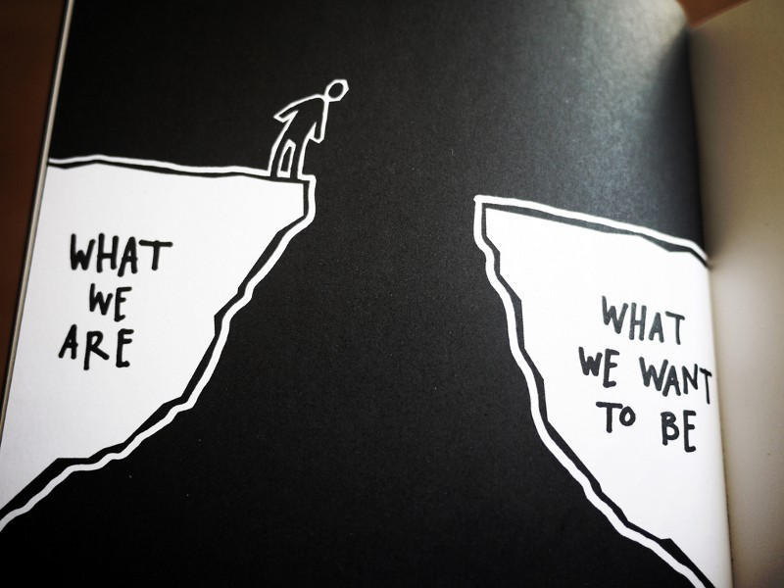
A Disconnect
The Philosophy
“Use the same skills with staff.”
Transitioning to PCS is a behavior change
PCS is grey
Is it the Same?
Accountability?
Scary to step out without
knowing what lies ahead
Notes:
This process was a bit disheartening for all involved. Ultimately, the philosophy is still valid. To succeed one must model the skills and support change along the way. Transitioning to a PCS approach IS a behavior change, but it is also necessary. When working with a client on the continuum of change, ultimately they make the decision that is best for themselves, their family and their situation. When working with a staff on the continuum of change…the question is this: is that change optional? We are held accountable to the families we serve, and the public to provide a quality service that supports a family’s strengths, challenges and motivations. We felt that ultimately, a PCS program is not an option. We also felt that we needed to somehow provide a more concrete guide, in a way that allowed the spirit of PCS to remain true, so that staff did not feel like they were walking out in to the dark and but also felt like they could find their own path.

Slide 7
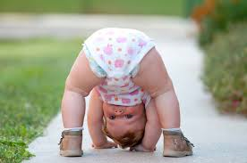
Bottom Line
People want to feel successful, want to do a good job
Create the “mark” so that the approach is more important than the what the client sets as their goal.
Notes:
The reason we felt this was because, the bottom line is EVERYONE, whether they are a parent making a feeding choice for their family, or a staff member offering a service, wants to feel like they are doing a good job.

Slide 8
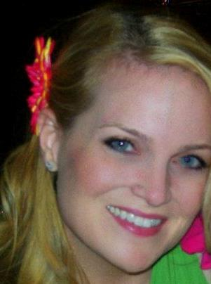
HOW??
How about a Rubric???
Notes:
So how in the world could we do this? Well, after many discussions with partners and key stakeholders, the brilliant Marlene Williams had an idea. She was a grad student at the time, and suggested a rubric, like one she had been accustomed to in that world.

Slide 9
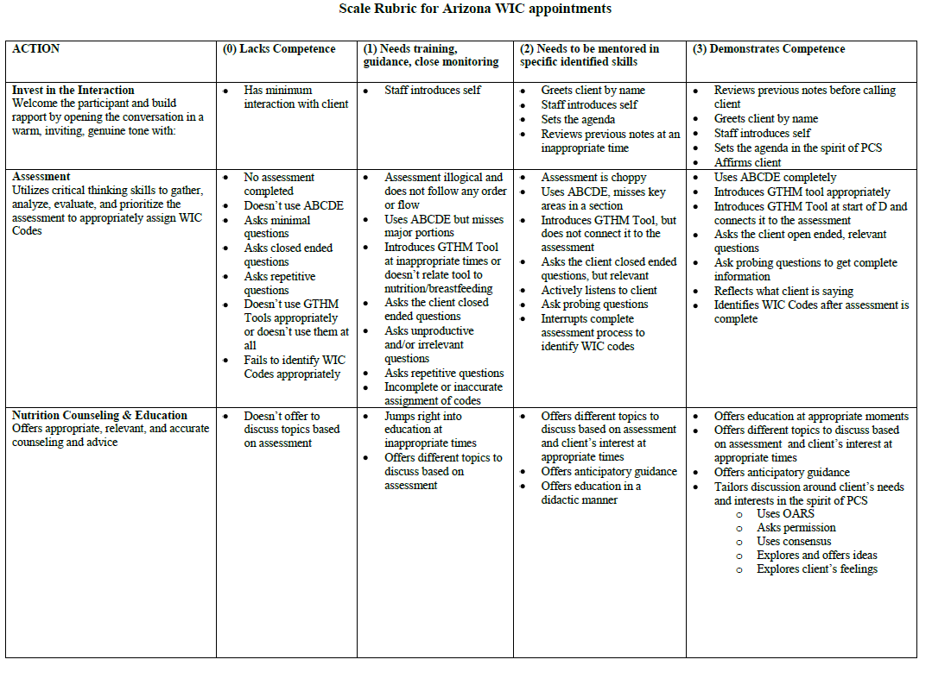
Rubric Development
Notes:
Thank you, Jaclyn. This is Marlene Williams, the Arizona WIC Program Integrity Manager. A few years ago I went back to school to earn my master’s degree, while still working full time for WIC conducting MEs. While in school, I observed that each of my instructors provided a grading rubric at the beginning of each semester or for each assignment. These rubrics let me and my classmates know what needed to be done to earn an A or B on an assignment. My classmates and I were on the same page as our instructors. We knew what they were expecting and looking for in our work. The rubrics that were provided to me helped me hit the target and earn good grades simply because I knew what was expected of me. It gave me a great advantage.
During MEs I realized that front line staff didn’t have the same advantage I had in my classes. They were not sure of what was expected of them, now that we had brought grey PCS into the black and white world of WIC policies, rules, and regulations. They were having a difficult time connecting the two. After talking with the nutrition services and training teams, we decided to develop a rubric that would show staff what was expected of them.
The rubric breaks down different aspects of a WIC appointment—eligibility, nutrition assessment, nutrition education, summarization, and documentation. If you look at the left side of the rubric, you can see a few of these different areas. You will also see four different columns, 0-3. A three being, “demonstrates competence,” meaning this is what a competent professional authority (CPA) will show during an appointment.
Next slide please.

Slide 10
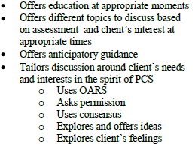
Structure of Rubric
Numeric scale (0 – 3) based on performance/completion of tasks
Scored on the approach to service
Notes:
The rubric allows an observer to score the observee on the HOW, not the WHAT. For example, you can see on this slide, the first two bullet points state, “offers education at appropriate moments,” and “offers different topics to discuss based on assessment and client’s interest at appropriate times.” Before the rubric, staff would sometimes jump right in and provide nutrition education, because that is one of the black and white rules, but they would either provide education that wasn’t relevant to the nutrition assessment, and/or would just give the client information at irrelevant times. An example of this would be when a client has a low hemoglobin reading. Instead of further assessing why the reading was low, staff would immediately being telling the client they needed to eat more iron rich foods. Staff did give nutrition education, but they missed the mark by not further assessing the situation, and determining if the client was even interested in discussing the issue. The rubric provides a better definition of what is expected, and our staff are now hitting the mark.
When some of our local agency clinic supervisors and trainers first saw the rubric, they were not very sure about it. Many thought it was to grey and subjective. I reminded them it was supposed to be grey and encouraged them to give it a try. Once they started observing an appointment, with the rubric in front of them, they would see it wasn’t subjective. Actually, it would made things more clearl on what was lacking from an appointment, and what targets were being hit.
Next Slide Please.

Slide 11
Literally On the Same Page
New Employee Training “Final Exam”
On-going Local Agency Self-Assessment
State Management Evaluation
Notes:
The rubric is now used to train all new Arizona WIC employees, and serves as the “final exam.”
Local Agencies use the rubric when observing their staff for their local agency self-assessment
As mentioned previously, it is also used during the ME. We are Literally on the same page. Being on the same page has made a difference in the ME process.

Slide 12
Difference in ME Process
Less “surprises” of what is expected
Engaging with Local Agency Staff
Immediate discussion and feedback
Same PCS soft skills used by State ME staff
Notes:
There are now less surprises at MEs in terms of what is expected from staff. This is because the rubric is a lot easier to read and refer to then the entire policy and procedure manual sections on how to conduct a certification and nutrition education appointment. Local agency directors and staff know what is expected of them and what the ME team is looking for.
After observing an appointment during an ME, state staff have a discussion with local agency staff and provide feedback. State staff use the same PCS/VENA skills on local agency staff that local agency staff use on clients. Local agency staff really appreciate this, not only because they like the way feedback is delivered, but also because they like seeing how the PCS/VENA soft skills can be incorporated into a different situation.
We are now going to go back to Jaclyn who will be reviews some limitations of the rubric as well as some examples of what a 0-3 nutrition education appointment can look like.

Slide 13
Limitations
Continued Training/Discussion
Provided initially
Training must include validity
Do we all agree?
Trainers Need Support/Mentoring
Application to real - life
Notes:
As with all projects, there are always two-sides to the story. The Rubric, though it helps shine light on a the approach, doesn’t get there on it it’s own. Some of the terms are still abstract and some what subjective. Words like “appropriate” and “relevant” assume you know the content well enough to make that assessment. It also might provide the content, but individuals still need help applying those concepts to a real-life situation. When we first implemented the rubric, we provided a training that included a video for feedback. Prior to this we also went to the clinics to validate the tool internally. Based on observations we were able to put examples together to demonstrate the application of the rubric.

Slide 14
0
“Oh, that’s really good that he likes broccoli. Okay, so let’s go over his checks.”
Notes:
To offer some examples of a 0 – 3 for Nutrition Education. Here is a 0. No offering of education.

Slide 15
1
“Oh he really likes chicken nuggets? You should offer other foods. It can sometimes take 10 – 20 times before a child will accept a new food. Oh he’s still on a bottle? You want to make sure to wean him as soon as possible. It can put him at risk for cavities or other problems.”
Notes:
Here is a 1 – Nutrition Education offered at inappropriate times. Here you can see the counselor is “knee-jerk” reacting to mom’s responses during the assessment with nutrition education. There is no connection or acknowledgement of client interest or motivation.

Slide 16
2
“So he’s a bit of a picky eater and you mentioned that he’s still on the bottle. We hear that the nighttime bottle is tough. You can put water in it and try that. The milk in it can cause baby bottle tooth decay.”
Notes:
Here a 2. Information is connected to a client concern, but necessarily offered with the finesse of PCS.

Slide 17
3
“So in general he’s growing well, though he is a bit picky. If you could change one thing about feeding Charlie, what would it be?...It sounds like you’ve been frustrated with weaning. You’re not alone, we hear that the night time bottle is tough.
Can I share a little info on that? Children his age are hardwired to like routines and the night time one can be especially tough to change! Some moms try adding a new comfort to the routine, before they offer the bottle. For example, one mom told us that she would massage her son first, and over time, he stopped asking for the bottle. How do you feel about that?”
Notes:
Here is an example of a full 3. The staff member summarized the assessment, identified the client’s concern, reflected and asked for permission and used open-ended questions. Note: we don’t necessarily expect ALL aspects to be here, but in general for the approach to have been attempted.

Slide 18
For More Information…
Jaclyn Chamberlain, MPH, RD, CSP
Arizona WIC Training Manager
Jaclyn.Chamberlain@azdhs.gov
Marlene Williams, MPH, RD
Arizona WIC Program Integrity Manager
Marlene.Williams@azdhs.gov
Notes:
A link to the rubric is on slide 9 and 10.

Slide 19
Oregon WIC: Role Modeling Participant Centered Services
putting VENA into action…
Notes:
Good afternoon! This is Vernita Reyna and I am a nutrition consultant with the Oregon WIC program. Today, Oregon will present with a focus on how state staff are putting VENA into action. Specifically, we will discuss how state staff model VENA including our approach to management evaluations and the collaborative work we do with local agency staff to achieve VENA competencies.

Slide 20
Notes:
VENA goals for staff interaction with participants are the same as Oregon’s goals for state interaction with local agency staff. We want to focus on strengths, develop rapport, and support achievement of desired outcomes. In Oregon, the desired outcome of state and local partnership is delivery of quality WIC services. The management evaluation process is an opportunity to work together toward assuring that this goal is met.

Slide 21
Less “Telling”, No “Yelling”
Notes:
When we work with participants in a VENA environment, we move away from focusing on the negative and instead, look for strengths to build on. As state staff, we thought… why not adopt this same approach with management evaluation? How effective is it for us to tell local agency staff everything that they are doing wrong and then tell them what they need to do to fix it? How does that reduce resistance and support behavior change? MEs provide a venue for using our VENA skills to provide mentoring and coaching for local agency staff in the same way we ask them to provide participant centered counseling and education to WIC families.

Slide 22
Strength Based
Local Agency Reviews
Notes:
In Oregon, this starts with our terminology for “management evaluations”. We call them local agency reviews. The use of different verbiage doesn’t change the fact that a review is a ME, but it sounds less intimidating! The reviewers are state nutrition consultants. The same nutrition consultants provide technical assistance and training to the agencies that where they conduct biennial monitoring. This fosters relationships that thrive outside of the review environment making reviews less adversarial. Enhanced relationships also helps to identify training needs for both the state as a whole and for individual local agencies. Reviewers meet once each month to discuss local agency successes and concerns and review best practices for improving the review process. Review tools are posted on the Oregon WIC website so review processes and objectives are transparent. Discussions occur between the reviewer and the local agency coordinator prior to the review so there is clarity as to expectations from both state and local staff. Reviewers enter a review looking for the positive and do not hesitate to identify strengths as they are demonstrated during an onsite visit.

Slide 23
Hitting the mark:
First we ask, then observe
and finally evaluate.
Notes:
When reviewers are on site, they model the same VENA skills that we want to see demonstrated at the local agency. For example, pre-visit conversations and entrance interviews at the time of arrival are used to set the agenda for the review. Open ended inquiries are made as to what is going well, what local agency staff are currently working on and what, if any, areas they feel might warrant special attention. Active listening is an integral part of the observations that are conducted. Affirmations are used to highlight positive actions and activities. Reflections assist with gaining clarity in complicated situations. Summaries are included in the exit interview as well as throughout the visit to assure that all aspects of the review process are covered. All of these OARS skills come into play while gathering the information needed to making assessments regarding compliance findings.

Slide 24
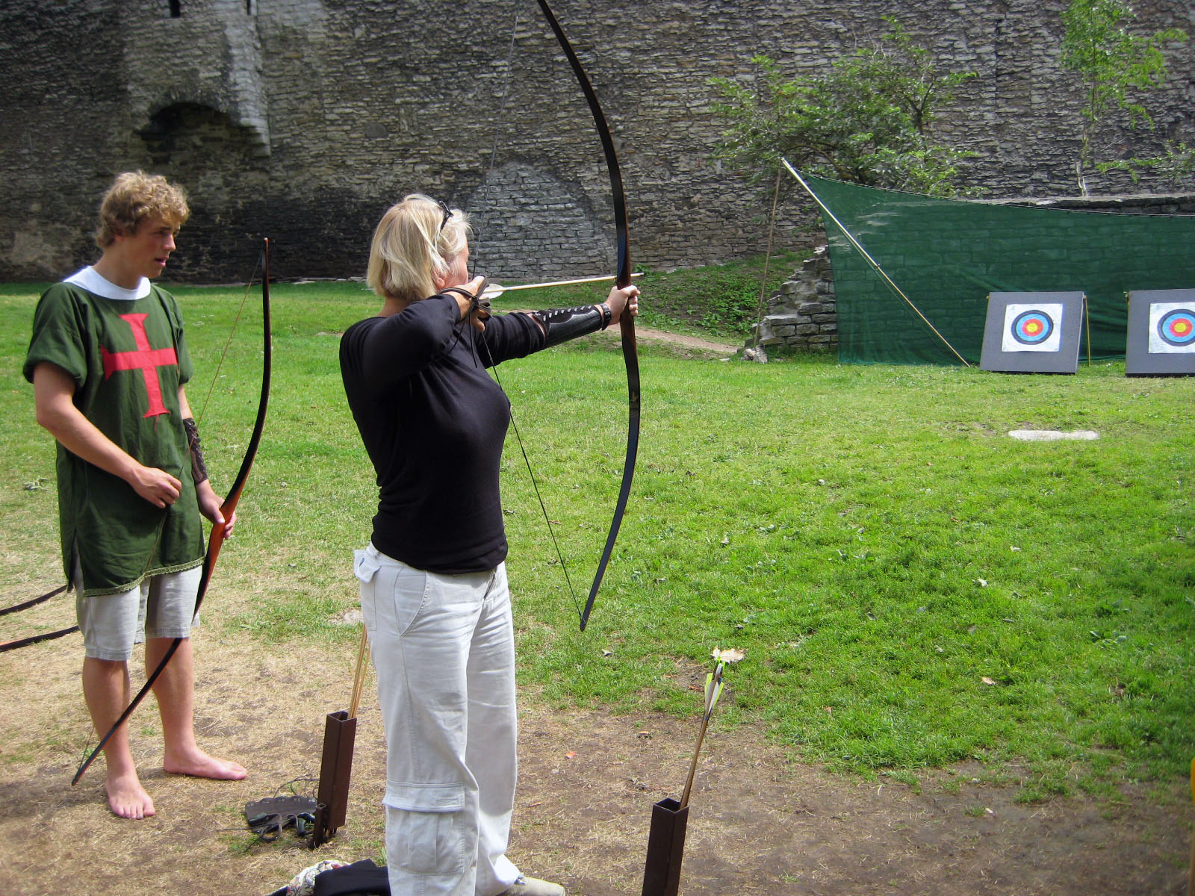
Providing feedback, coaching and mentoring
using OARS
Notes:
OARS skills are also utilized when offering feedback following each observation. Staff are asked what they thought went well or what they might have done differently upon reflection. To underscore the value of each staff member, efforts are made to include all staff, certifiers and clerical staff, in the observation process so everyone has ownership of the review outcome and each has an opportunity to be heard. In addition to compliance findings, commendations are always shared at exit interviews and included in review documentation. Compliance findings are viewed as an opportunity to enhance services not as a denigration of local agency efforts. Collaboration is offered in identifying and implementing resolutions for these findings. VENA skills are a key component of the mentoring and coaching utilized to address these local agency issues and concerns.

Slide 25
Creating quality relationships:
supportive versus adversarial
Notes:
Once each review cycle, compliance findings are compiled and compared to previous cycles. This summary is shared statewide and guides state training efforts as we take responsibility for helping agencies come into and stay in compliance. In the past biennium, this summary illustrated a need to focus more closely on staff training and nutrition assessment. Two projects that we are currently working on in Oregon are the direct outcome of findings identified during the review process.

Slide 26
Local Agencies are our partners in hitting the mark.
We ask for their input on how to do that best.
Notes:
To support our relationships with local agencies, we ask for their input. By establishing this pattern of behavior, we build trust that the efforts we ask them to make, the projects we ask them to take on, will be responsive to their needs and interests. This approach has been effectively utilized during quarterly meetings with local agency program coordinators, nutritionists, and breastfeeding coordinators groups. Recently, training supervisors have been involved in planning a workshop based on needs that they identified.

Slide 27
A survey of
Training Supervisors resulted in formation of a
Training Supervisors Forum.
Notes:
In our state, training supervisors are key local agency staff who take responsibility for guiding the training of new employees and for providing continuing education for existing staff. When training needs surfaced during the review process, key informant interviews were conducted with training supervisors. Their input lead to the development of a training supervisor’s forum that will be held over one and one half days in May of this year.

Slide 28
Local training supervisors are helping design the forum and develop tools
Notes:
The training supervisor’s identified goals related to provision of effective training, feedback and mentoring to their staff in order to achieve VENA competencies. A volunteer workgroup is actively engaged in designing the forum content and in provided resources for a training supervisor’s toolkit to be offered in conjunction with the forum.

Slide 29
Nutrition Assessment Training
Notes:
During our local agency reviews, the review team also identified a need to strengthen diet assessment and critical thinking associated with nutrition counseling. A project was launched called ENACT (Enhanced Nutrition Assessment Certifier Training). Local agency input was requested to gather information regarding challenges with assessment. 33 certifying staff from 22 of our 34 local agencies participated on two conference calls.

Slide 30
Local agency certifiers
shared insights for improving
the assessment process
Notes:
State staff heard that the questionnaires in our data system needed updating and local agency staff provided suggestions for what that improvement might look like. This resulted in a plan to add more age appropriate questionnaires. For example, instead of having one questionnaire for all infants from birth to 12 months, we will now have three questionnaires for ages birth to 5 months, 6 to 9 months and 10 to 12 months with questions that target the characteristics of each age group. A similar adjustment will be made to the children’s questionnaires. In addition, a small workgroup of key certifiers volunteered to assist with a review of questionnaire questions resulting in the rewording of some questions. These changes, along with assessment skills training, are in development and will be available for statewide implementation this summer.

Slide 31
Collaborate.
Notes:
And special projects are not the only area where state staff have focused on the spirit of participant centered services. There have been changes in the way in which we conduct our internal business including team meetings. Collaboration and clear communication is a key within each team and between different teams. In addition, we’ve seen enhanced relationships with vendors as vendor trainers adopted PCE approaches to required training. The help desk or App support at the state use VENA based skills when assisting users with data systems issues. Relationships have been established so that many callers are on a first name basis with the state staff and feel comfortable asking for help.

Slide 32
Nutritionists
Certifiers
Coordinators
Training Supervisors
Working together to hit the mark!
Notes:
All of these examples are ways in which Oregon WIC staff are making participant centered services a part of our daily work. VENA skills have helped us establish and maintain collaborative relationships with our local agency partners. We are a stronger program by putting VENA into action!

Slide 33
To contact Oregon WIC
Staff
Website
Vernita Reyna, Nutrition Consultant
Vernita.d.reyna@state.or.us
971-673-0047
Kim McGee, Training Coordinator
Kimberly.o.mcgee@state.or.us
971-673-0049
Staff training and Resources launch page
https://public.health.oregon.gov/HealthyPeopleFamilies/wic/Pages/wic_staff.aspx
Local Agency Review Tools
https://public.health.oregon.gov/HealthyPeopleFamilies/wic/Pages/wic-coordinator.aspx
Notes:
For more information and resources from Oregon WIC, please visit our website at the address noted on this final slide. If you would like to connect with myself or with our training coordinator, Kim McGee, the contact information is also listed here. We would be glad to discuss Oregon’s continuing journey with VENA! Thank you for your time and attention today…now I’ll turn the presentation back to FNS…

Slide 34
Thank you!
Thank you for your participation.
Thank you for your hard work.
Stay tuned for the next webinar – tentatively scheduled for Fall 2015.
Notes:
Thank you for joining us on today’s webinar. Also, thank you for your hard work.
Please stay tuned for the date and topic of the next webinar tentatively scheduled for Fall 2015.

